Slide 1
HIVE

Slide 2
Tool to impose structure on variety of data formats and enable easy access to data via SQL

Slide 3
SENSOR DATA ANALYSIS USING HIVE

Slide 4
Download and Extract the data
wget http://s3.amazonaws.com/hw-sandbox/tutorial14/SensorFiles.zip
unzip SensorFiles.zip
cd SensorFiles
Manually Remove the header of both the csv files
vim HVAC.csv
vim building.csv

Slide 5
Upload Data to HDFS
hdfs dfs -copyFromLocal HVAC.csv /bdatraining/
hdfs dfs -copyFromLocal building.csv /bdatraining/

Slide 6
Create Table in HIVE
CREATE EXTERNAL TABLE hvac_raw(date_str STRING, time STRING, TargetTemp INT, ActualTemp INT, System INT, SystemAge INT, BuildingID INT) ROW FORMAT DELIMITED FIELDS TERMINATED BY',' LINES TERMINATED BY '\n' STORED AS TEXTFILE LOCATION '/hvac_table;

Slide 7
Map Schema with File
LOAD DATA INPATH '/bdatraining/HVAC.csv' INTO TABLE hvac_raw;

Slide 8
Check if data can be queried
SELECT * from hvac_raw

Slide 9
CREATE raw_building table and Load Data into it

Slide 10
CONVERT TABLES TO ORC
CREATE TABLE hvac STORED AS ORC AS SELECT * FROM hvac_raw;
CREATE TABLE buildings STORED AS ORC AS SELECT * FROM building_raw;

Slide 11
TRANSFORM THE TABLE
CREATE TABLE hvac_temperatures as select *, targettemp - actualtemp as temp_diff, IF((targettemp - actualtemp) > 5, 'COLD', IF((targettemp - actualtemp) < -5, 'HOT', 'NORMAL')) AS temprange, IF((targettemp - actualtemp) > 5, '1', IF((targettemp - actualtemp) < -5, '1', 0)) AS extremetemp from hvac;

Slide 12
JOIN TABLES
create table if not exists hvac_building as select h.*, b.country, b.hvacproduct, b.buildingage, b.buildingmgr from buildings b join hvac_temperatures h on b.buildingid = h.buildingid;

Slide 13
Zeppelin Notebook
Select Interpreter as JDBC
Execute Following Query
%jdbc(hive) select country, extremetemp, temprange from hvac_building;

Slide 14
Try Website Clickstream Data
https://hortonworks.com/tutorial/visualize-website-clickstream-data/

Slide 15
Spark Streaming
Spark Architecture
Overview of RDD
Streaming Overview
DStream

Slide 16
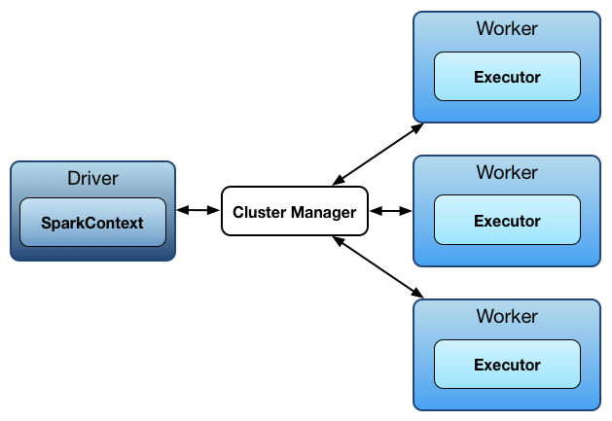

Slide 17
RDD
val lines = sc.textFile("hdfs://hostname/path/to/file")
Lines here is RDD
RDD is always the Arrays/List representation of whole data distributed into the cluster

Slide 18
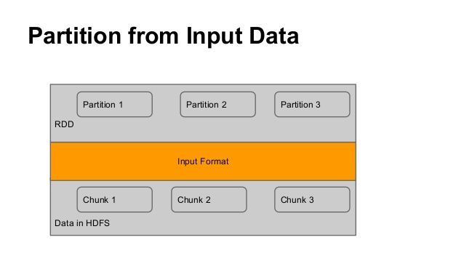
RDD Partitioning

Slide 19
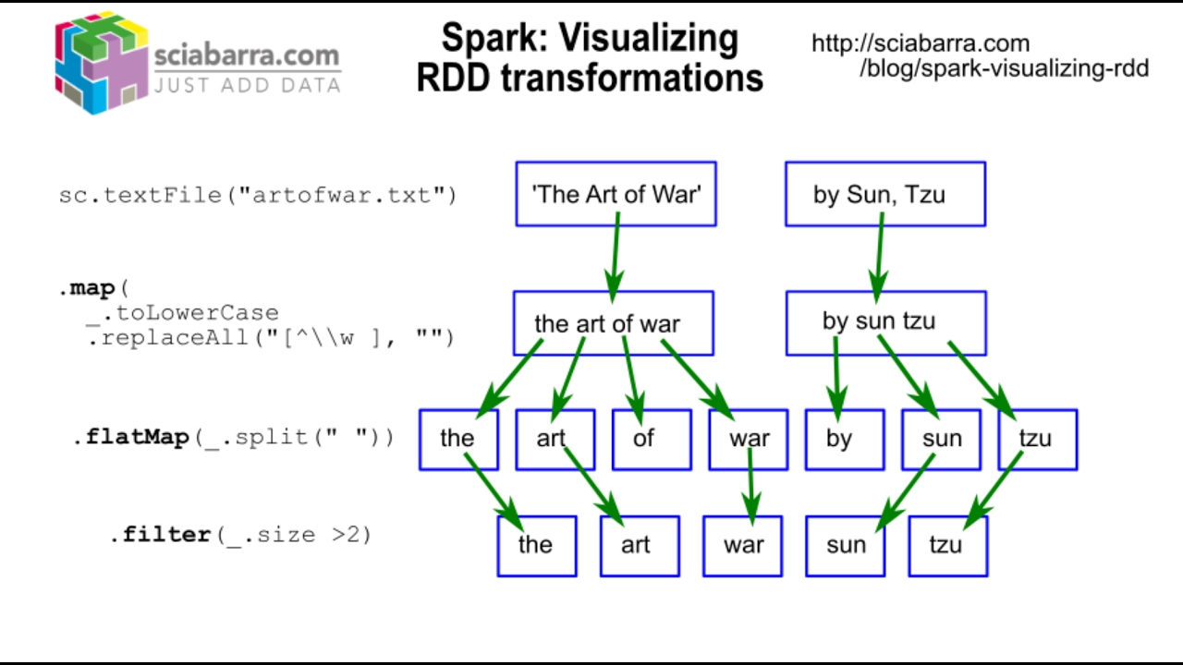
RDD Transformations

Slide 20
Running Spark Program
Try out word count program in spark-shell
val lines = sc.textFile("data.txt") val pairs = lines.map(s => (s, 1)) val counts = pairs.reduceByKey((a, b) => a + b)

Slide 21
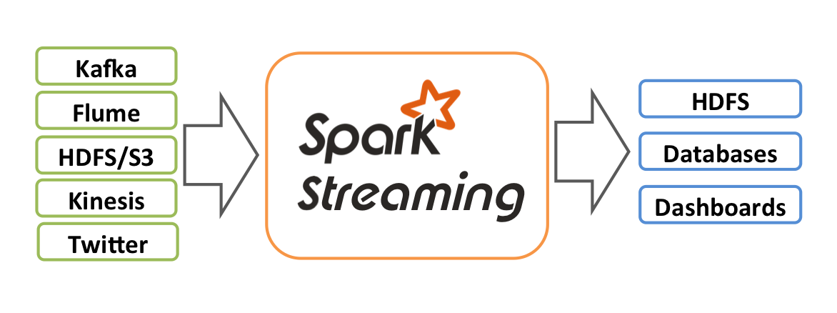
Streaming

Slide 22
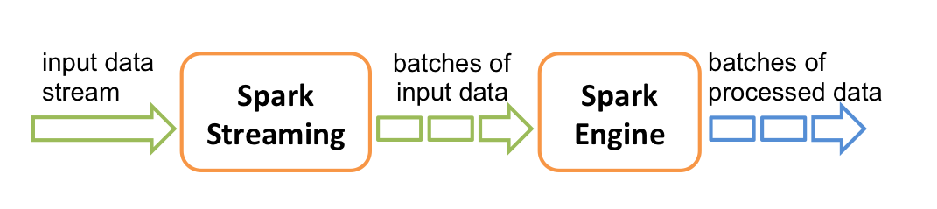
Dividing Data into batches

Slide 23
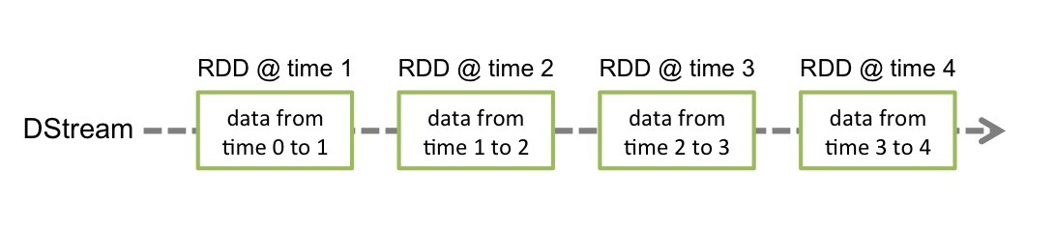
Discretized Streams (DStreams)

Slide 24
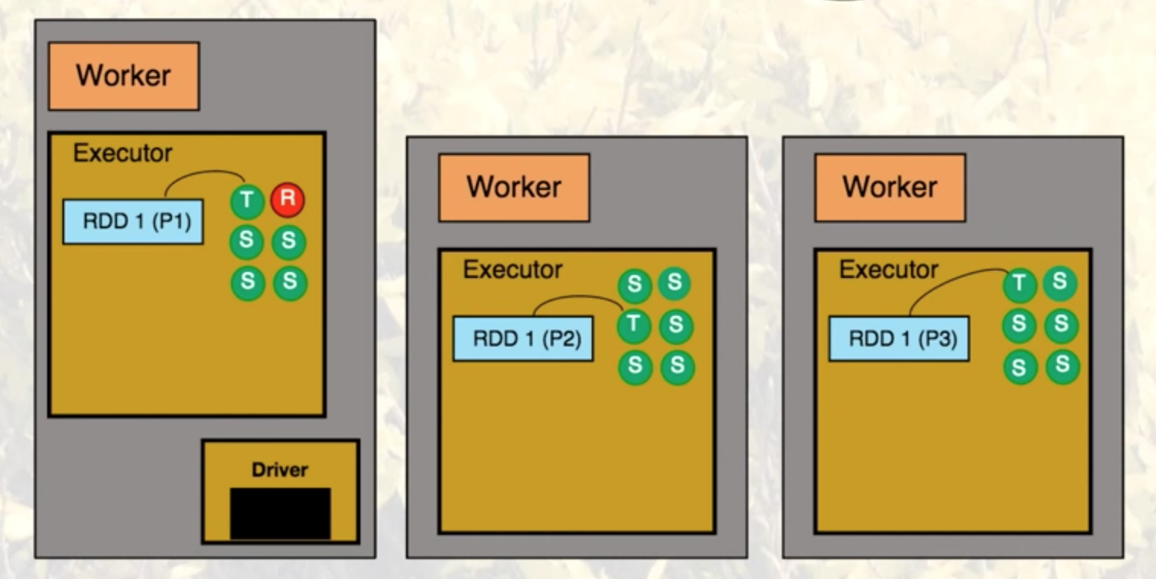
Resilience and Receiver Thread

Slide 25
Try Running WordCount in Streaming
Create a file spark-streaming.py
http://spark.apache.org/docs/latest/streaming-programming-guide.html#a-quick-example
run nc -lk 9999 on another ssh window
spark-submit spark-streaming.py

